Slide 1

Node JS
Node JS Tutorial
Engr. Rabbil Hasan

Slide 2
Node JS
WHAT IS NODE JS?
নোড জেএস এর গল্প

Slide 3
JavaScript Dec 1995-2009 April
JavaScript created as client side language/front end language. Only handle front end logics . JavaScript
has no power to communicate with server.
JavaScript Can Do :
Interact with temporary storage
Make interactive web pages
Interact with local storage
Sending request for data to server
Send request to server
work as an interface between server and user
JavaScript Can Not Do:
Querying the database
Operations over databases
Access/Write a file on server.
Server Side Request , Response Handle
Software Backend Operations.

Slide 4

JavaScript From May-2009
Ryan Dahl Create An Awesome Platform May -2009
This is Node JS
Using Node JS Platform JavaScript Can Do:
Querying the database
Operations over databases
Access/Write a file on server.
Server Side Request , Response Handle
Software Backend Operations.

Slide 5
Node JS
JavaScript Library
JavaScript Library
Node JS Platform
JavaScript Library
JavaScript Library
Node JS Own Library
JavaScript Library

Slide 6
Node JS Application
Third Party
JS Library
Third Party
JS Library
Third Party
JS Library
Third Party Library Management
NPM (Node Package Manager)
Third Party
JS Library
Node JS
Own Library
Third Party
JS Library
Third Party
JS Library
Third Party
JS Library
Third Party
JS Library

Slide 7
Node JS Frequently Asked Questions
Is Node js a programming language ?
What previous knowledge required for Node JS ?

Slide 8
Node JS Tools
Node Js Environment
VS Code

Slide 9
Terminal
TOOLS
Node.js
VS Code
Webstrome
TERMINAL
Windows CMD
Windows PowerShell
VS Code Terminal Option
Webstrom Terminal
Node js Terminal

Slide 10
Node.js Module
What is module?

Slide 11
Node.js Module
Module in Node.js is a simple / complex functionality organized in
single or multiple JavaScript files.
Node.js includes three types of modules:
Core Modules
Local Modules
Third Party Modules

Slide 12
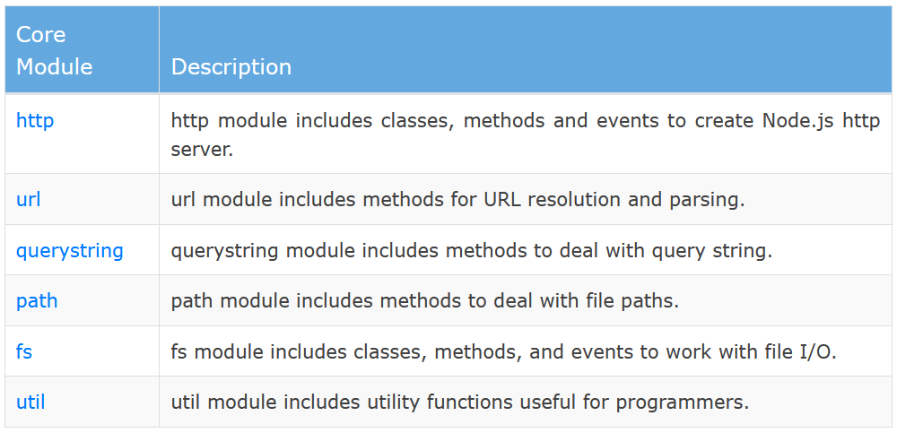
Node.js Core Module

Slide 13
Http/Https Protocol
REQUEST RESPONSE
MODEL

Slide 14


Http/Https Protocol এ কি ঘটনা ঘটে
Http Request
Response
Client Computer
Server

Slide 15
Http/Https Protocol এ কি ঘটনা ঘটে
HTTP REQUEST METHODS
GET()
DELETE()
POST()
PUT ()
OPTIONS()
HEAD()

Slide 16
Http/Https Protocol এ কি ঘটনা ঘটে
Response
Status Code
Data
200/404/500….
Head
Body

Slide 17
Http Client
যাহা সার্ভারে HTTP Request পাঠায় এবং Response Receive করে,
তাহাকেই HTTP Client বলে
Example Of HTTP Client
Axios
Fetch
Jquery Ajax
cURL
Volly
Retrofit
RestSharp
HTTP Client For Testing
Postman
Fiddler

Slide 18
Package.json
Application এর নথি
Holds various metadata relevant to the project
handle the project's dependencies
Used identify the project
Used to hold application information

Slide 19
Node.js URL Module
Built-in URL Module
The URL module splits up a web address into readable parts.
http://rabbil.com/blog.html?year=2020&month=july;

Slide 20
Node.js fs module
Node.js includes fs module to access physical file system.
The fs module is responsible for all the asynchronous or synchronous file I/O operations.
Synchronous: Loading…. Loading… you wait for it to finish….After finish you can move.
Asynchronous: No Loading… No Loading … no need to wait…. you can move.

Slide 21
Node.js fs module essentials operation Asynchronous
Method | Description
fs.readFile(fileName [,options], callback) | Reads existing file.
fs.writeFile(filename, data[, options], callback) | Writes to the file. If file exists then overwrite the content otherwise creates new file.
fs.rename(oldPath, newPath, callback) | Renames an existing file.
fs.exists(path, callback) | Determines whether the specified file exists or not.
fs.unlink(path, callback); | File delete
fs.appendFile(file, data[, options], callback) | Appends new content to the existing file.
fs.open(path, flags[, mode], callback) | Opens file for reading or writing.
fs.mkdir(path[, mode], callback) | Creates a new directory.
fs.rmdir(path, callback) | Renames an existing directory.
fs.readdir(path, callback) | Reads the content of the specified directory.

Slide 22
Node.js fs module essentials operation Synchronous
Method | Description
fs.readFileSync(fileName [,options]) | Reads existing file.
fs.writeFileSync (filename, data[, options]) | Writes to the file. If file exists then overwrite the content otherwise creates new file.
fs.renameSync(oldPath, newPath) | Renames an existing file.
fs.existsSync (path) | Determines whether the specified file exists or not.
fs.unlinkSync (path); | File delete
fs.appendFileSync (file, data[, options]) | Appends new content to the existing file.
fs.openSync (path, flags[, mode]) | Opens file for reading or writing.
fs.mkdirSync (path[, mode]) | Creates a new directory.
fs.rmdirSync (path) | Renames an existing directory.
fs.readdirSync (path) | Reads the content of the specified directory.

Slide 23
Synchronous Asynchronous
Understanding Synchronous Asynchronous Theory
Real Example For Clear Concept

Slide 24
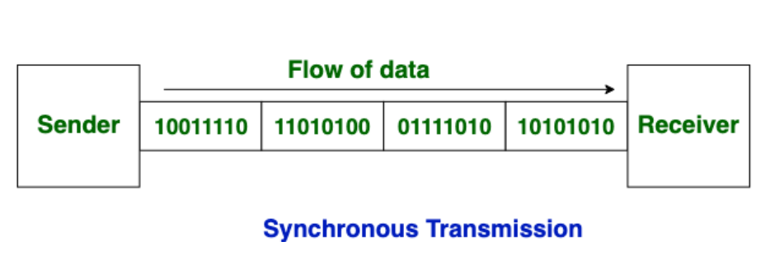
Synchronous Theory
Data is sent in form of blocks or frames.
This transmission is the full duplex type.
There is no gap present between data
Synchronous transmission is fast.
More efficient and more reliable for large amount of data.

Slide 25
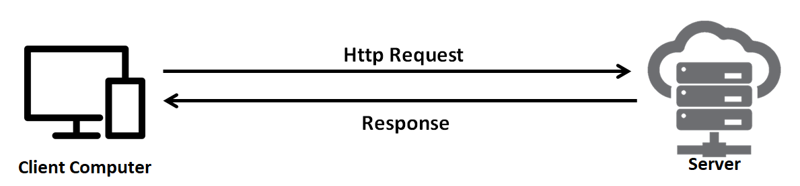
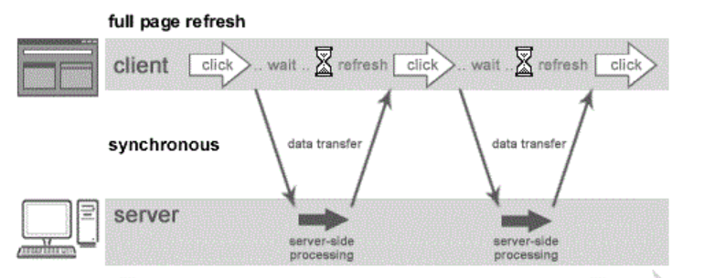
Synchronous Theory
Loading Loading…..
You wait for it to finish
After finish you can move.

Slide 26
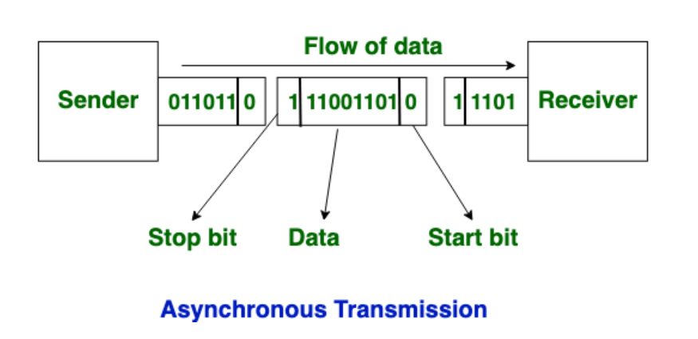
Asynchronous Theory
This transmission is the half duplex type transmission
Start bits and stop bits are added with data.
Data is sent in form of byte or character.
Asynchronous transmission is slow.
There is present gap between data.

Slide 27
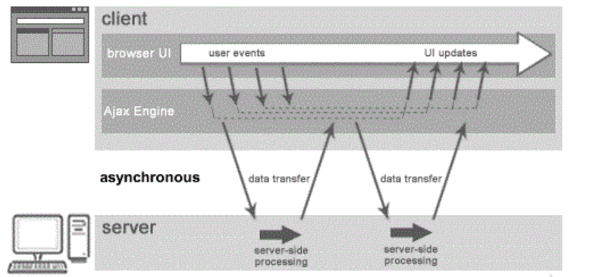
Asynchronous Theory
No Loading… No Loading …
No need to wait….
You can move.

Slide 28
Synchronous Asynchronous
কখন কোনটি

Slide 29


Synchronous is Suitable
Request
Simple Server
Site Process
Response

Slide 30
Asynchronous is Suitable
Say YouTube Video Upload
Compress
Formatting
Request
Upload
Response
Copyright

Slide 31
Node js website

Slide 32
Node JS Debugging
Core Node.js debugger
Node Inspector
Built-in debugger in IDEs

